Slide 1
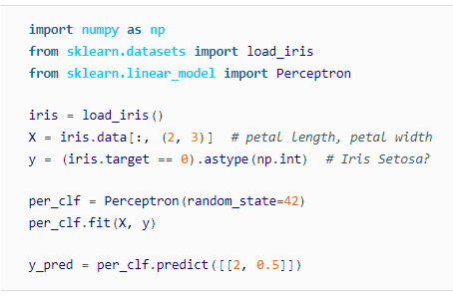

Slide 2
The Perceptron learning algorithm strongly resembles - Stochastic Gradient Descent(SGD).
In fact, Scikit-Learn’s Perceptron class is equivalent to using an SGDClassifier with the following hyper parameters:
loss="perceptron", learning_rate="constant", eta0 =1 (the learning rate), and penalty=None (no regularization).
Note that contrary to Logistic Regression classifiers, Perceptrons do not output a class probability; rather, they just make predictions based on a hard threshold.
This is one of the good reasons to prefer Logistic Regression over Perceptrons.

Slide 3
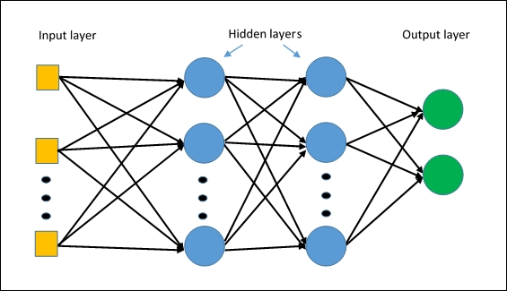

Slide 4
MLP with Back propagation
Rumelhart introducing the back propagation training algorithm for MLP.
BP has two phases: Forward Pass and Backward Pass
Forward pass phase: computes ‘functional signal’, feed forward propagation of input pattern signals through network
For each training instance, the algorithm feeds it to the network and computes the output of every neuron in each consecutive layer
Backward pass phase: computes ‘error signal’, propagates the error backwards through network starting at output units (where the error is the difference between actual and desired output values)

Slide 5
It then proceeds to measure how much of these error contributions came from each neuron in the previous hidden layer—and so on until the algorithm reaches the input layer.
This reverse pass efficiently measures the error gradient across all the connection weights in the network by propagating the error gradient backward in the network (hence the name of the algorithm).

Slide 6
For each training instance the back propagation algorithm :
First makes a prediction (forward pass),
Measures the error,
Then goes through each layer in reverse to measure the error contribution from each connection (reverse pass),
and finally slightly tweaks the connection weights to reduce the error (Gradient Descent step).

Slide 7
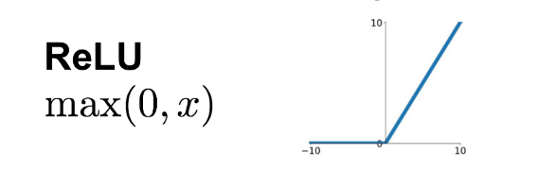
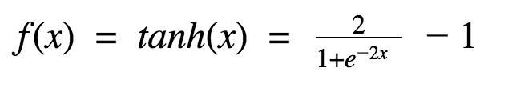
Key change to the MLP’s architecture
To work algorithm properly ,
the step function replaced with the logistic function, σ(z) = 1 / (1 + exp(–z)).
Because ,
The step function contains only flat segments - Gradient Descent cannot move on a flat surface
The logistic function has a well-defined nonzero derivative everywhere, allowing Gradient Descent to make some progress at every step.
The back propagation algorithm also used with two more popular activation functions :

Slide 8
The hyperbolic tangent function: tanh (z) = 2σ(2z) – 1
It is S-shaped, continuous, and differentiable, but its output value ranges from –1 to 1 (instead of 0 to 1 in the case of the logistic function),
which tends to make each layer’s output more or less normalized (i.e., centered around 0) at the beginning of training. This often helps speed up convergence.
The ReLU function: ReLU (z) = max (0, z).
It is continuous but unfortunately not differentiable at z = 0 (the slope changes abruptly, which can make Gradient Descent bounce around).
In practice it works very well and has the advantage of being fast to compute.
Most importantly, the fact that it does not have a maximum output value also helps reduce some issues during Gradient Descent

Slide 9
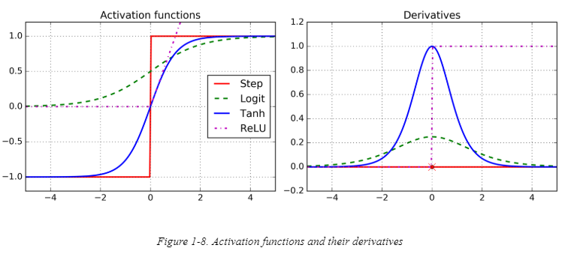

Slide 10
Conceptually: Forward Activity - Backward Error

Slide 11
Forward Propagation of Activity
Step 1: Initialise weights at random, choose a learning rate η
Until network is trained:
For each training example i.e. input pattern and target output(s):
Step 2: Do forward pass through net (with fixed weights) to produce output(s)
i.e., in Forward Direction, layer by layer:
Inputs applied
Multiplied by weights
Summed
‘Squashed’ by sigmoid activation function
Output passed to each neuron in next layer
Repeat above until network output(s) produced

Slide 12
Step 3. Back-propagation of error

Slide 13
‘Back-prop’ algorithm summary (with NO Maths!)

Slide 14
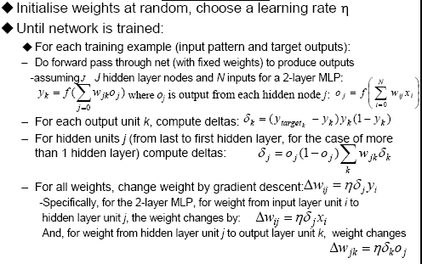
‘Back-prop’ algorithm summary (with Maths!) (Not Examinable)

Slide 15
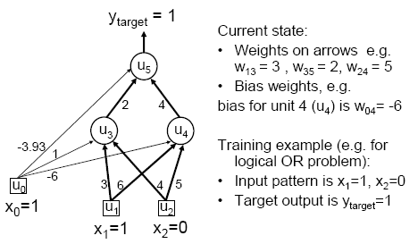
MLP/BP: A worked example

Slide 16
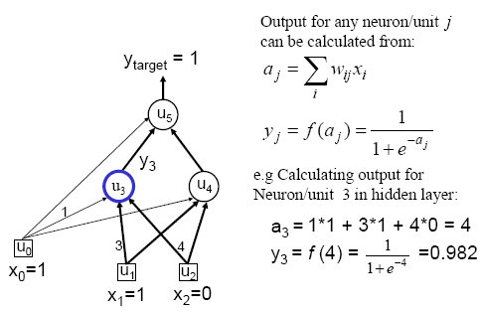
Worked example: Forward Pass

Slide 17
Worked example: Forward Pass

Slide 18
Worked example: Backward Pass

Slide 19
Worked example: Update Weights Using Generalized Delta Rule (BP)
Update = LearningFactor· (DesiredOutput − ActualOutput) · Input

Slide 20
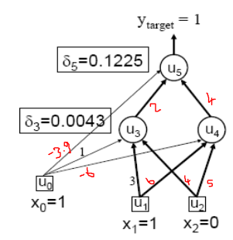
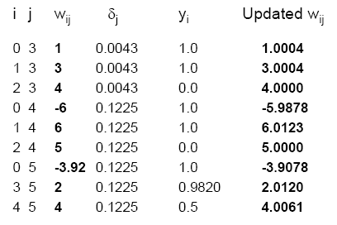
Similarly for the all weights wij:

Slide 21
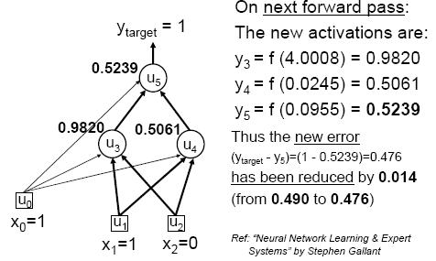
Verification that it works

Slide 22
Assign all network inputs and output
Initialize all weights with small random numbers, typically between -1 and 1
repeat
for every pattern in the training set
Present the pattern to the network
// Propagated the input forward through the network:
for each layer in the network
for every node in the layer
1. Calculate the weight sum of the inputs to the node
2. Add the threshold to the sum
3. Calculate the activation for the node
end
end
// Propagate the errors backward through the network
for every node in the output layer
calculate the error signal
end
for all hidden layers
for every node in the layer
1. Calculate the node's signal error
2. Update each node's weight in the network
end
end
// Calculate Global Error
Calculate the Error Function
end
while ((maximum number of iterations < than specified) AND
(Error Function is > than specified))

Slide 23
An MLP is often used for classification, with each output corresponding to a different binary class
e.g., spam/ham, urgent/not-urgent, and so on.
When the classes are exclusive (e.g., classes 0 through 9 for digit image classification), the output layer is typically modified by replacing the individual activation functions by a shared softmax function.
The output of each neuron corresponds to the estimated probability of the corresponding class.
Note that the signal flows only in one direction (from the inputs to the outputs), so this architecture is an example of a feedforward neural network (FNN).

Slide 24
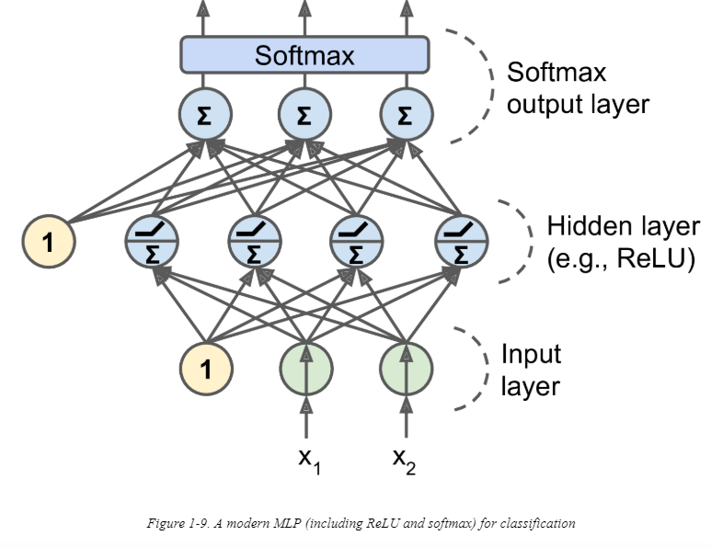

Slide 25
Biological neurons seem to implement a roughly sigmoid (S-shaped) activation function, so researchers stuck to sigmoid functions for a very long time.
But it turns out that the ReLU activation function generally works better in ANNs.

Slide 26
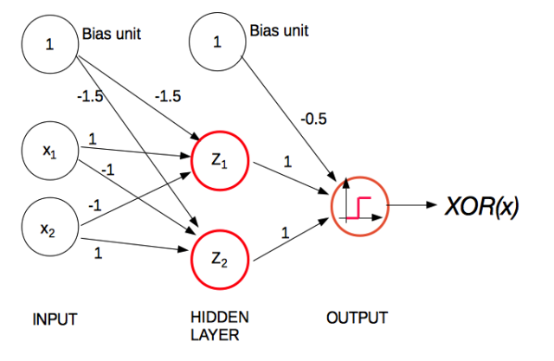
Example

